Slide 1


Dispute Processing
15-Feb-2011
Prepared By:
J.S.Padmanabhan

Slide 2
Agenda
  Dispute Processing – Overview
  Chargeback Processing
  Outgoing file generation
  Thumb rules for responding to Chargeback

Slide 3
Dispute Processing - Overview
Dispute module has facilities to capture process & track different dispute transactions
  Retrieval Request
  Retrieval Request Fulfillment
  Chargeback
  Re Presentments
  Pre Arbitration
  Arbitration
  Pre Compliance
  Compliance

Slide 4
RR Processing
Transactions are captured into the system using the following functions:
  GUI
  Interchange Incoming files (MasterCard and Visa)
RR Processing in MAPS
  Generate Letters
  Capture Merchant Response
  Mark RR for Fulfillment/Non Fulfillment/Transfer

Slide 5
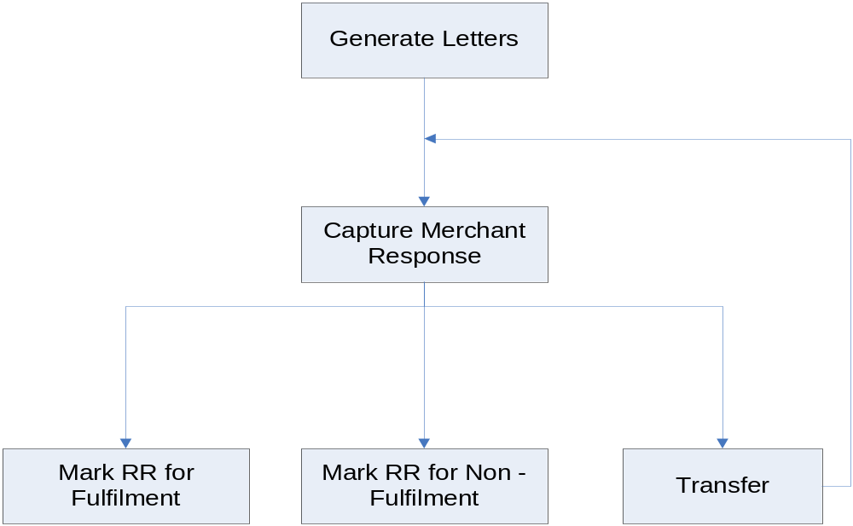
RR Flow

Slide 6
Chargeback Processing
  Generate Letters
  Capture Merchant Response
  Mark for Recovery
  Mark for Refund
  Mark for Representment
  Write – Off
  Chargeback Process
  Close Dispute Transaction
  Open Dispute Transaction
  Define Pre-Arbitration and Arbitration
  Define Pre-Compliance and Compliance

Slide 7
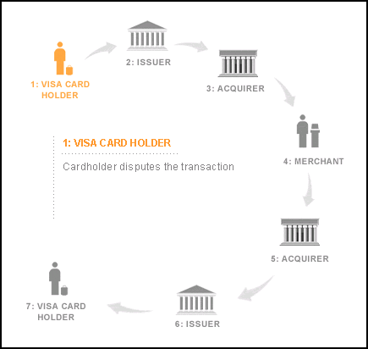
Chargeback Cycle

Slide 8
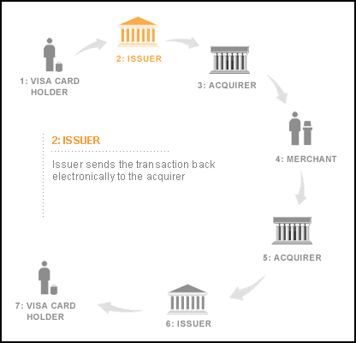
Chargeback Cycle..

Slide 9
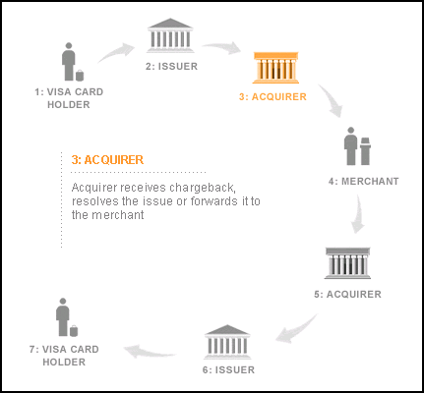
Chargeback Cycle..

Slide 10
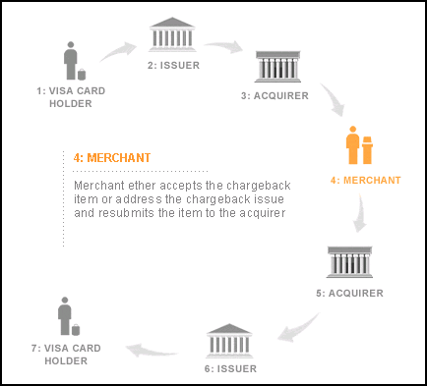
Chargeback Cycle..

Slide 11
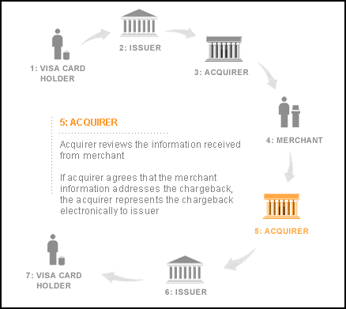
Chargeback Cycle..

Slide 12
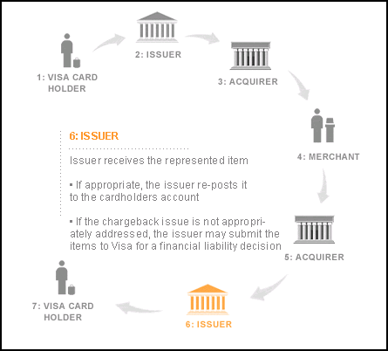
Chargeback Cycle..

Slide 13
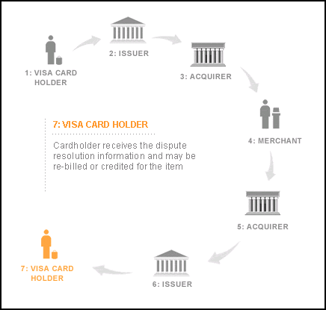
Chargeback Cycle..

Slide 14
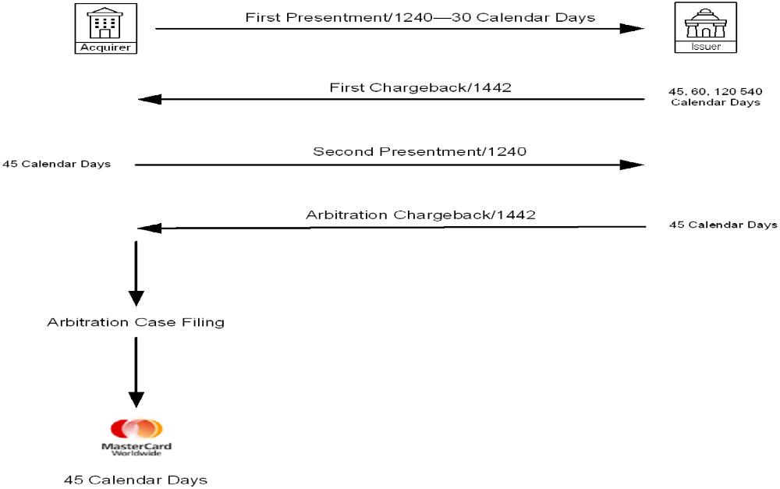
Master Card Cycle & Time Frames

Slide 15
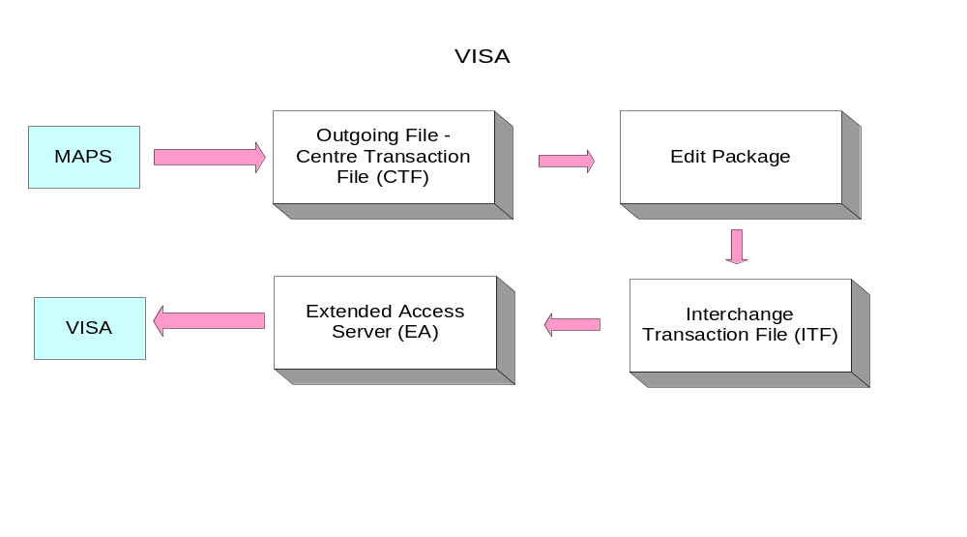
Outgoing File - Visa

Slide 16
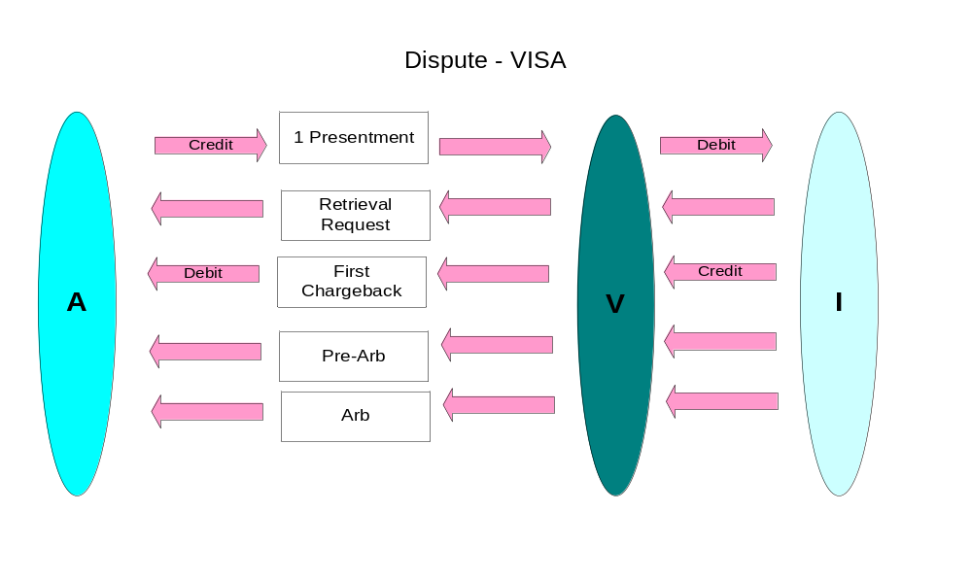
Visa Flow
A – Acquirer, V – Visa, I - Issuer
Notes:
A – Stands for Acquirer

Slide 17
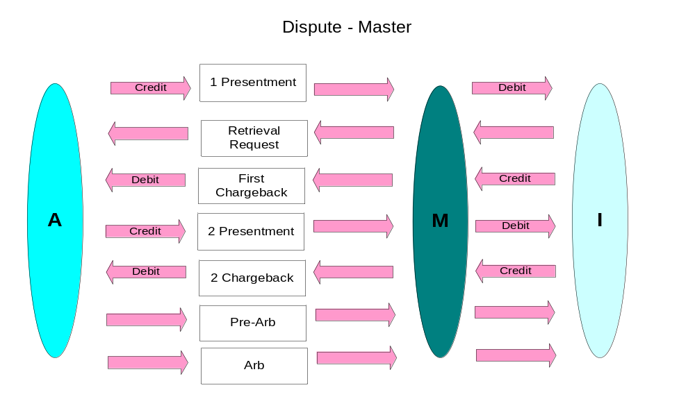
MasterCard Flow
A – Acquirer, M – MasterCard, I - Issuer

Slide 18
Thumb Rules
Know your re-presentment rights to avoid unnecessary losses for your business.
  for eg:
  Time frames (Late Presentment & Late Chargeback)
  Expired Card
  Already Credit Processed
  Already Refund Processed
Act promptly according to Timeframes.
Always refer the Scheme manuals before taking any decision with regard to disputes as it may vary for different reason codes.
Respond to a Chargeback as quickly as possible.

Slide 19
Thank You

